Slide 1
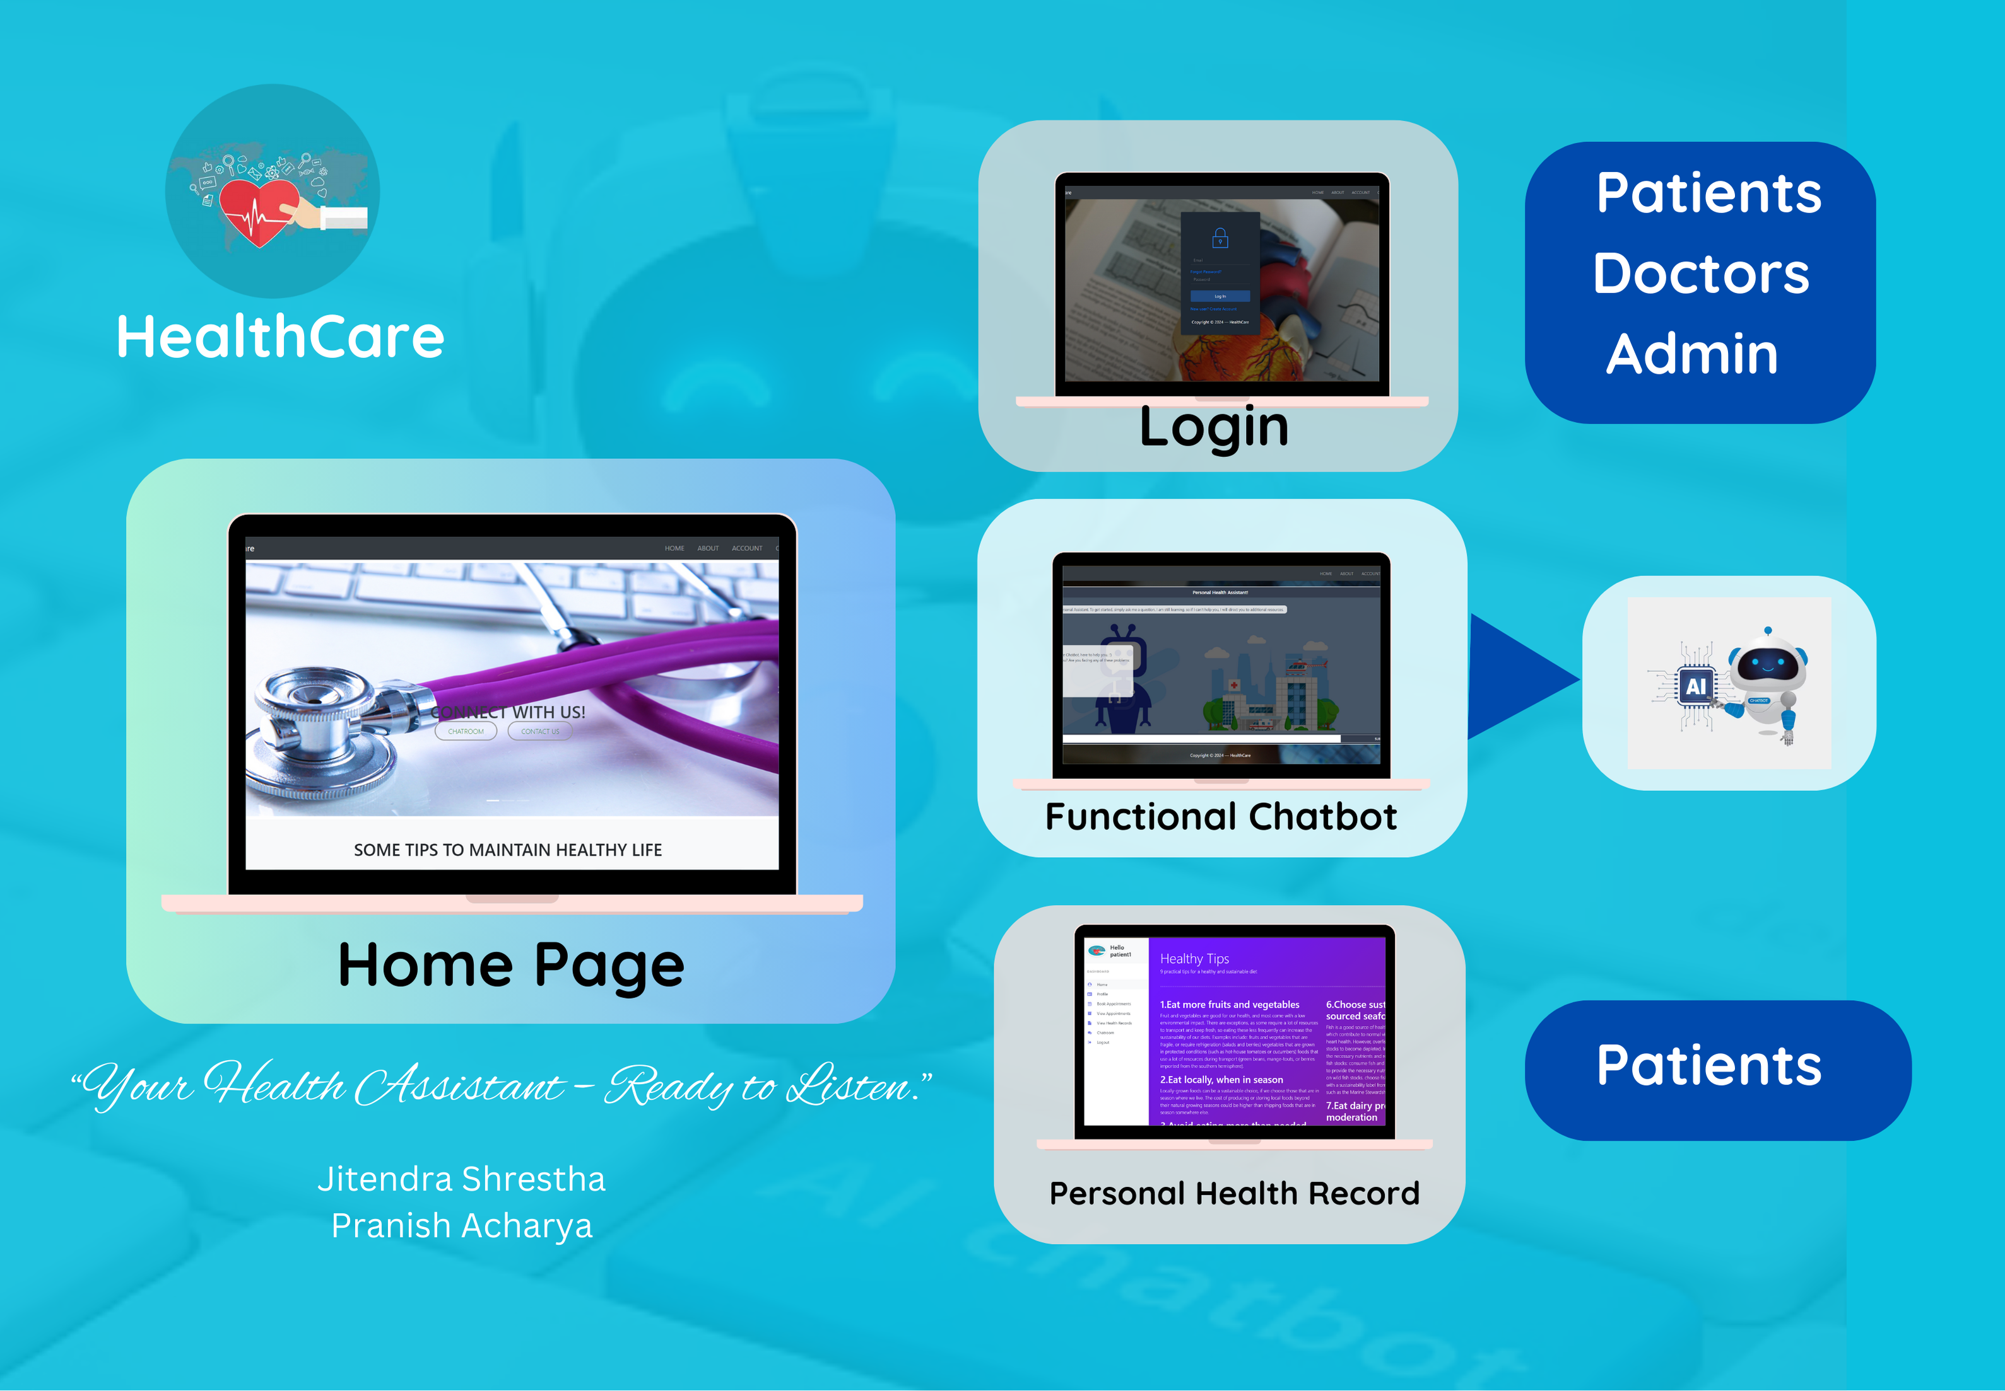

Slide 2


HEALTHCARE CHATBOT SYSTEM
TEAM MEMBERS:
JITENDRA SHRESTHA
PRANISH ACHARYA

Slide 3
TEAM CONTRIBUTION
Team Member | Contribution
Jitendra Shrestha | Database Management UI Design Frontend Development Frontend Integration with chatbot Unit Testing and UI Testing Documentation
Pranish Acharya | Chatbot Logic Implementation using NLP Data Classification Train Chatbot Dialogue Management API Development for chatbot Documentation

Slide 4
INTRODUCTION
Service that provides to the user/client through interpreting natural language
Serves as healthcare assistant
Provides quick responses to common medical symptoms
Seamless User Experience

Slide 5
OBJECTIVES
To provide response on health queries
To diagnose disease based on symptoms provided based on yes/no statement
To provide way to maintain patient health record

Slide 6
FEATURES
Can predict disease based on symptoms provided
User can book appointment
User can view health records
Doctors can provide prescription to booked appointment
Admin can manage doctors

Slide 7
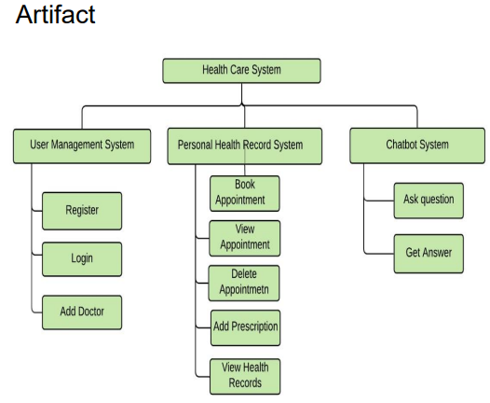
SYSTEM ARCHITECTURE

Slide 8
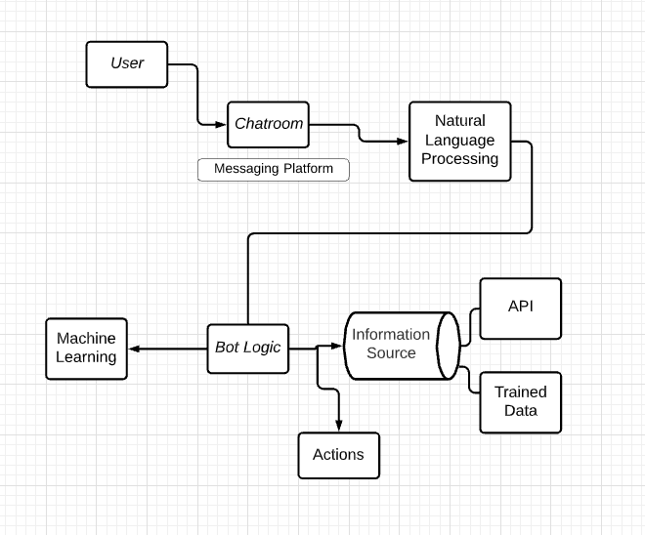
CHATBOT ARCHITECTURE

Slide 9
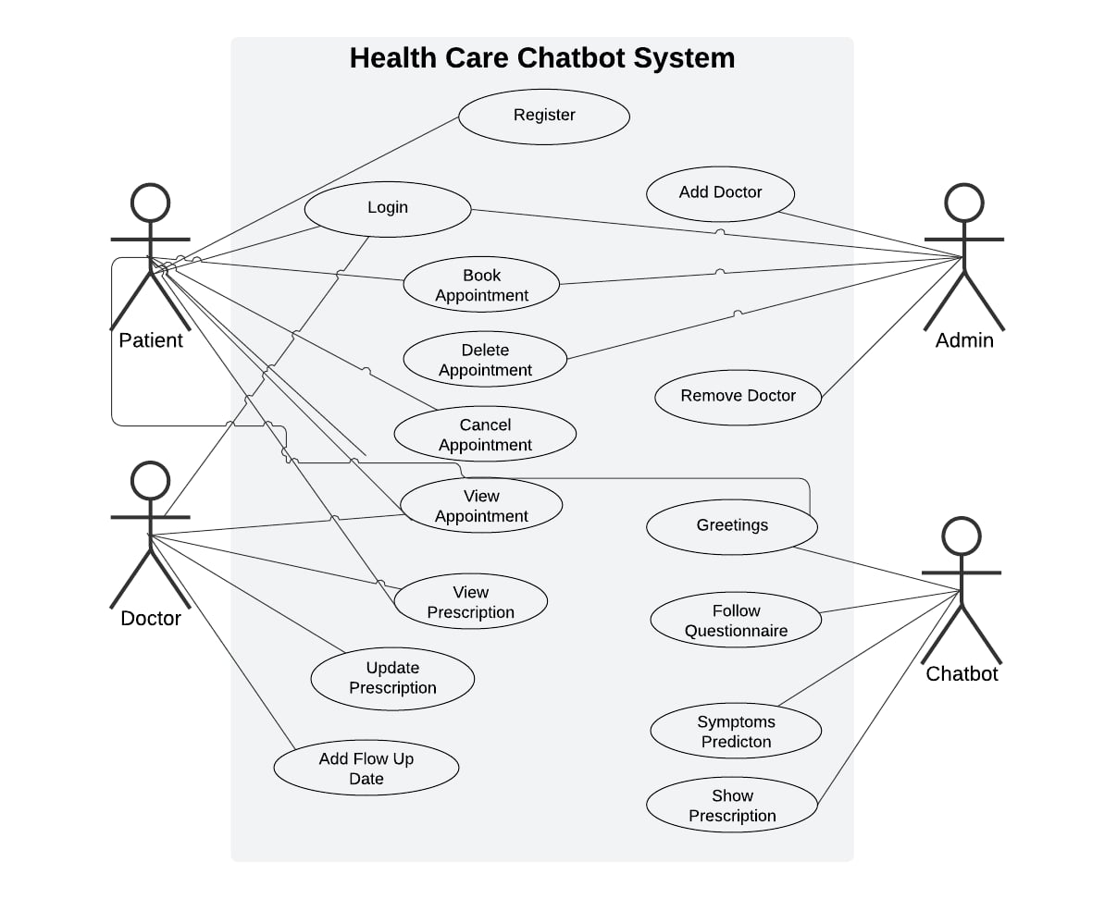
OVERALL USE CASE DIAGRAM

Slide 10
IMPLEMENTATION PLAN
Planning & Design
Development
Testing and Quality Assurance
Refinement and Finalization
Deployment and Project Closure
Initiation

Slide 11
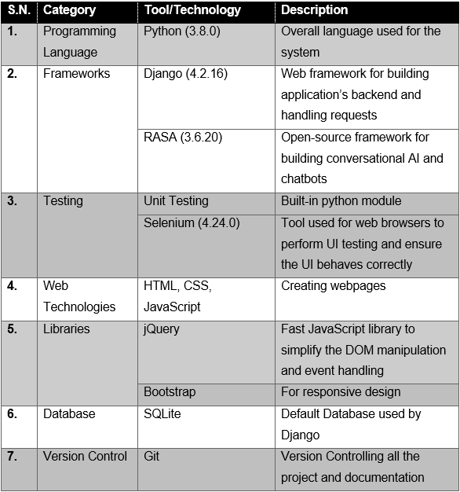
TOOLS & TECHNOLOGIES

Slide 12
ALTERNATIVE TOOLS
Chatbot Logic : Google Dialogflow, chatterbot
Frontend: React based on JavaScript
Backend: Node.js Framework
Database: MongoDB
Project Management: Asana

Slide 13
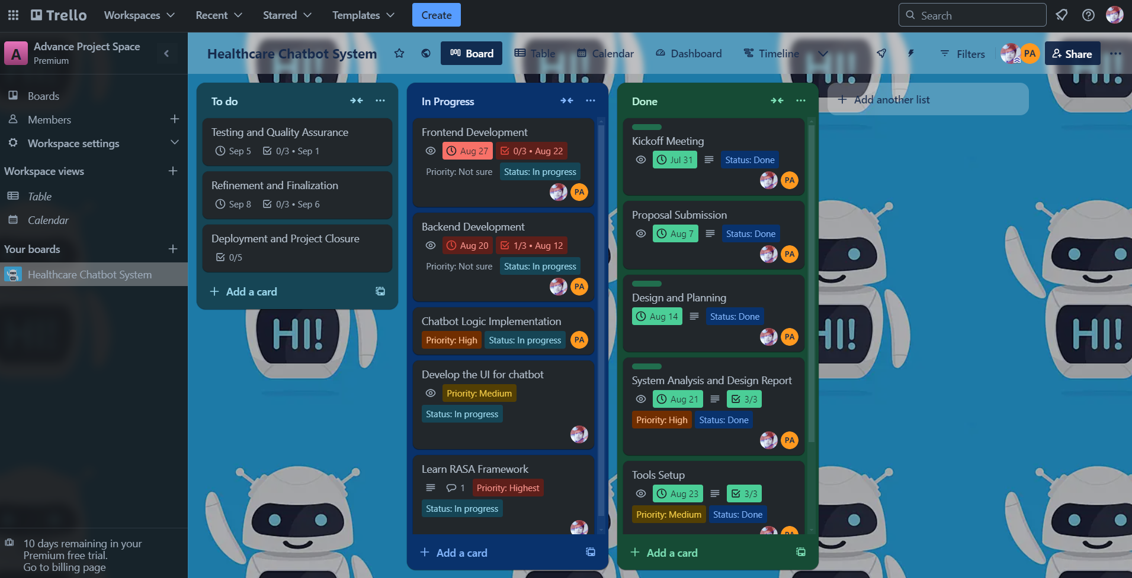
PROJECT MANAGEMENT

Slide 14
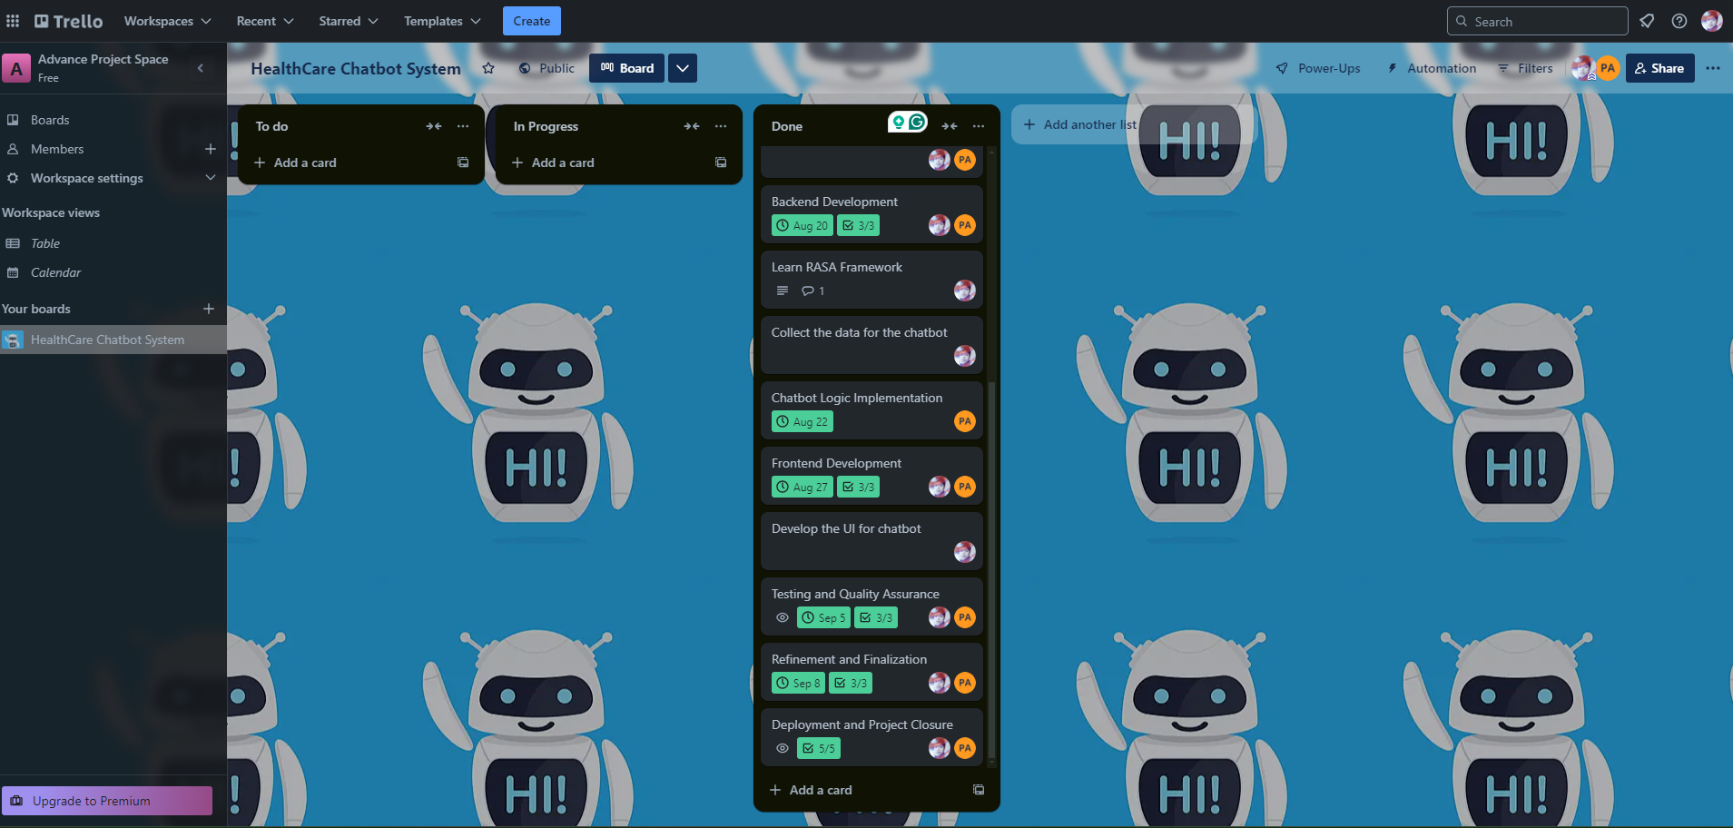
PROJECT MANAGEMENT- Contd.

Slide 15
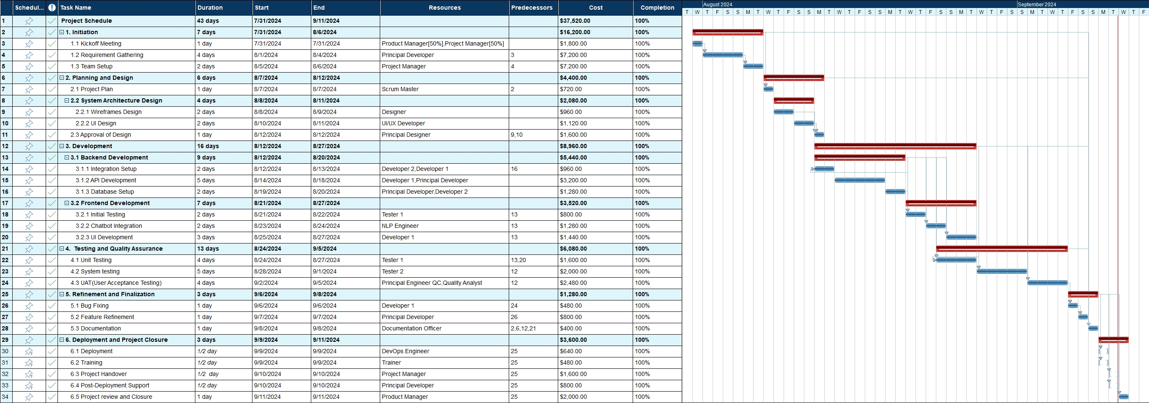
PROJECT SCHDEULE

Slide 16
PROJECT TIMELINE

Slide 17
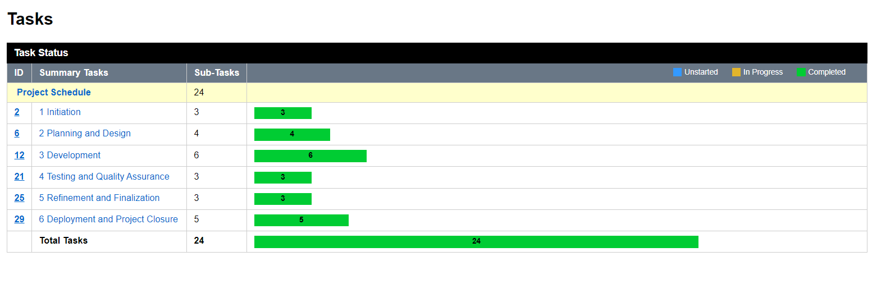
PROJECT PROGRESS

Slide 18
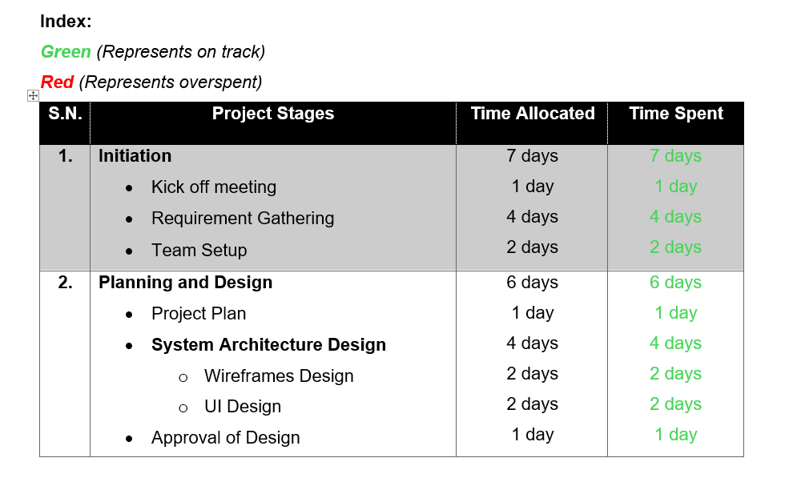
TIMELINE COMPARISON

Slide 19
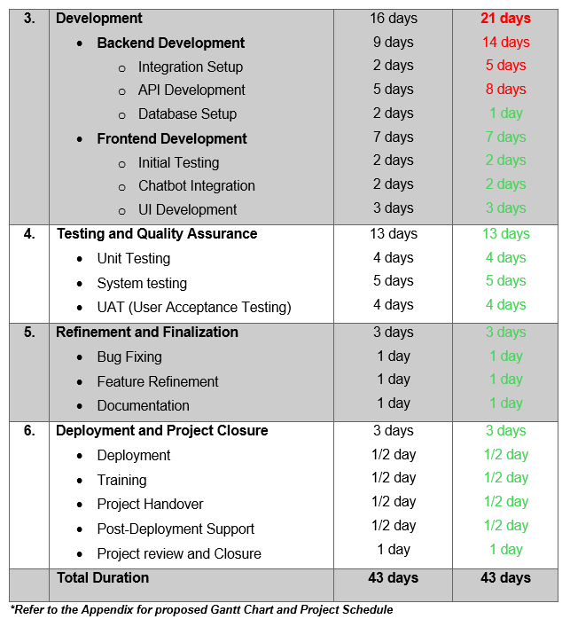
TIMELINE COMPARISON- Contd.

Slide 20
REASON FOR BEHIND THE SCHEDULE
Integration Setup
Version issues
Data Collection
API Development

Slide 21
FUTURE ENHANCEMENTS
Patient can book appointment through chatbot
Work on chatbot using more dialogues
More diseases can be predicted

Slide 22
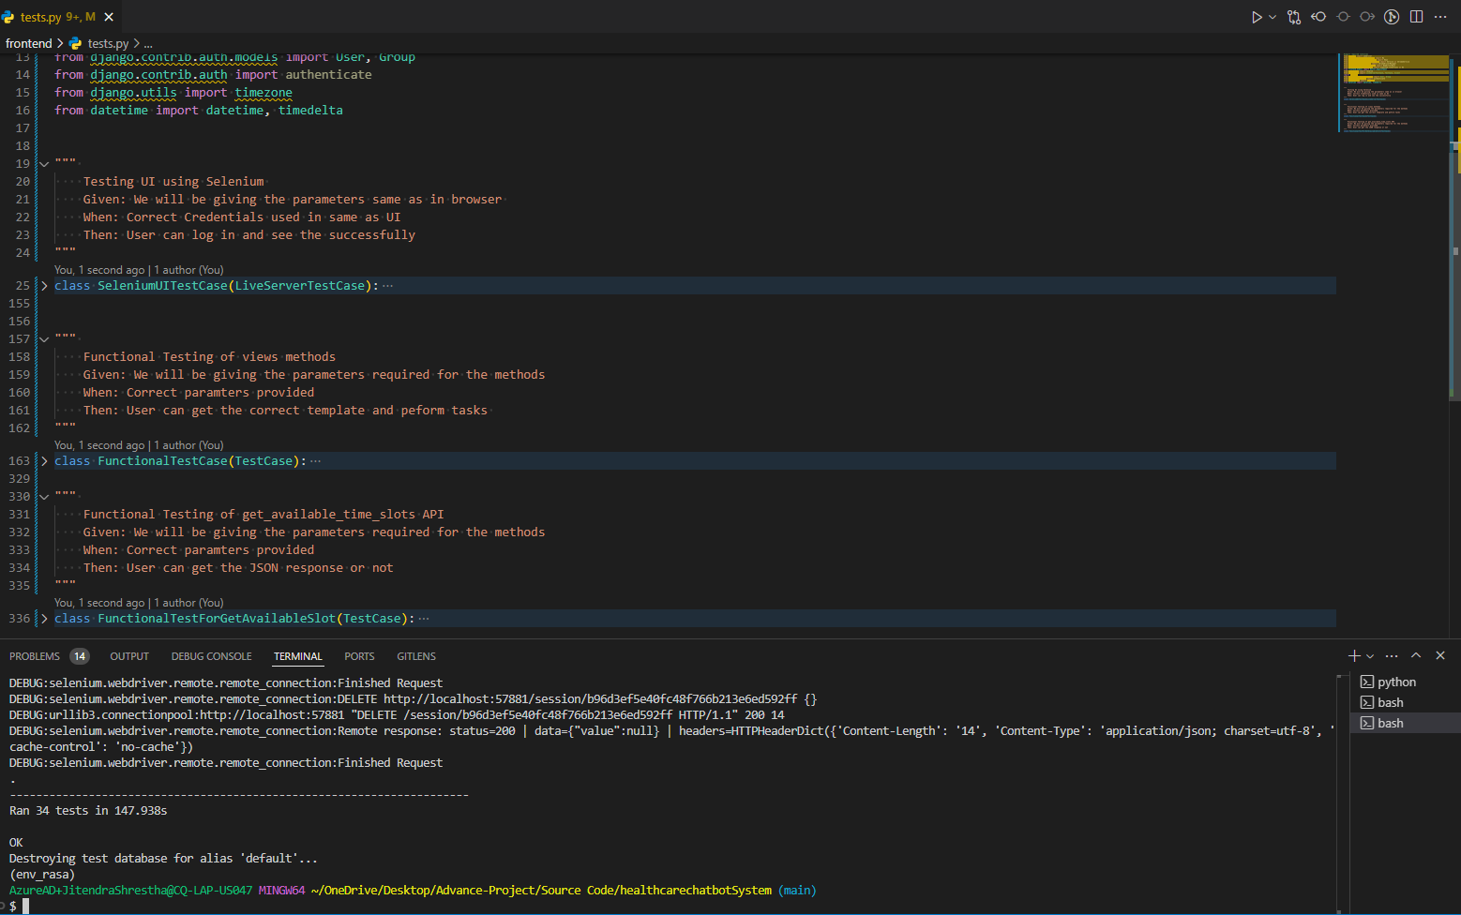
TESTING
Unit Testing
Using built-in python
UI Testing
Using Selenium

Slide 23
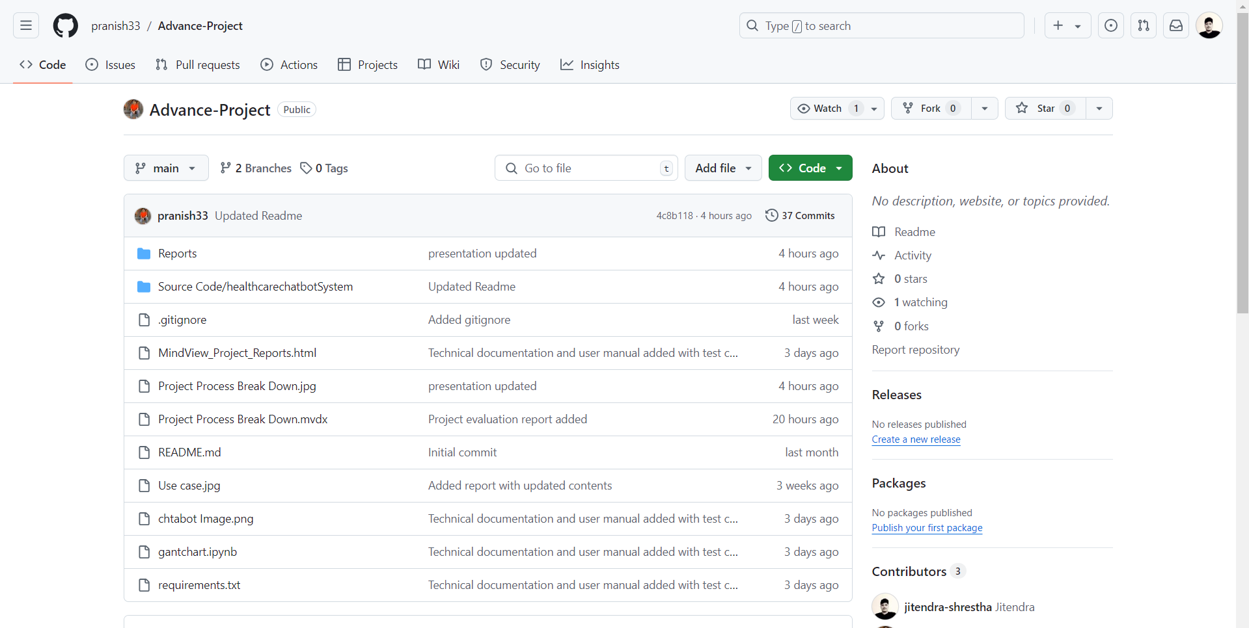
VERSION CONTROL
Used GitHub for remote access
Used git for local

Slide 24
Some Screenshots of System

Slide 25
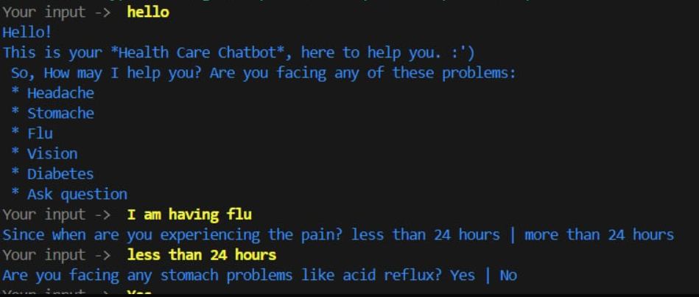

Slide 26
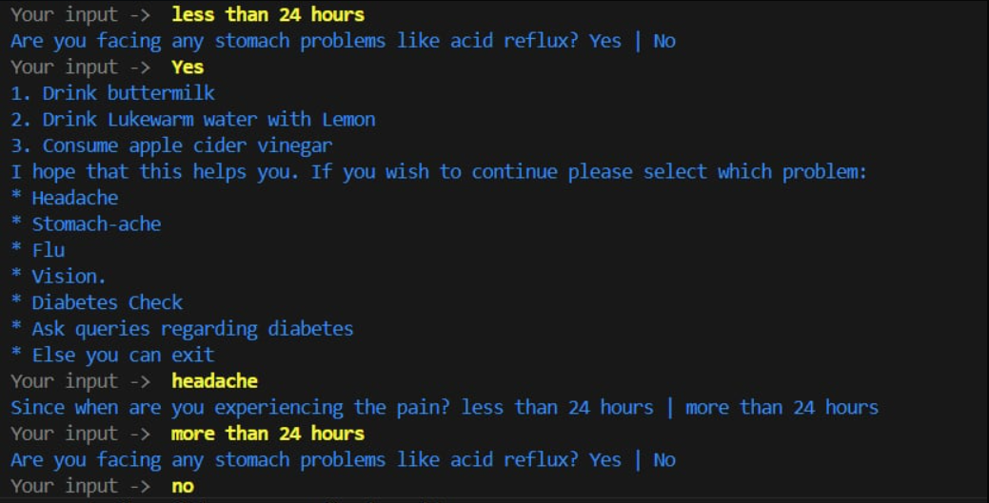

Slide 27
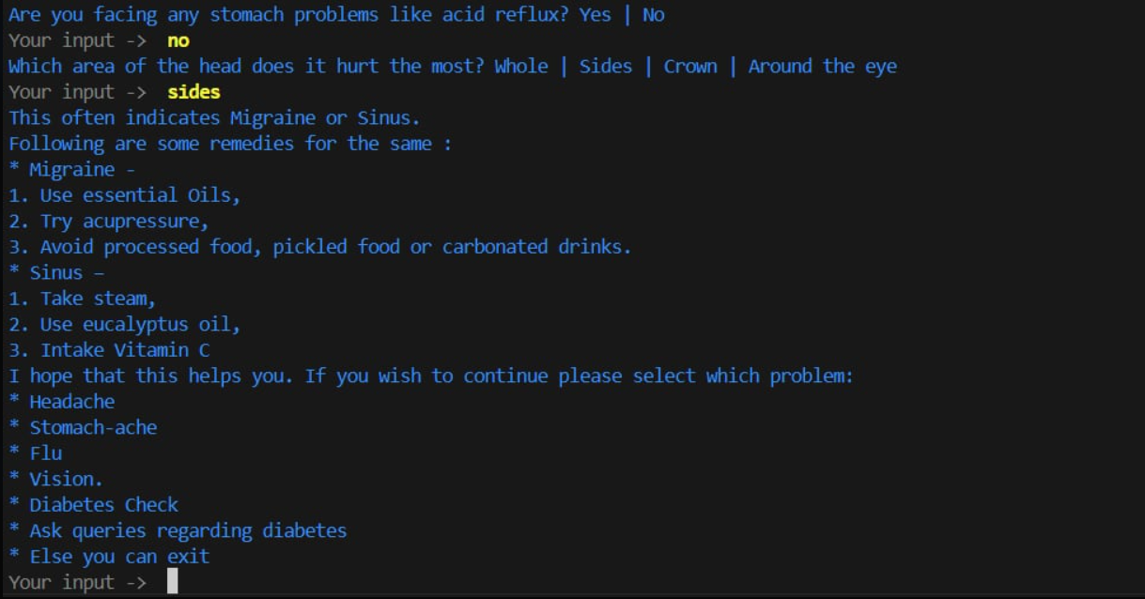

Slide 28
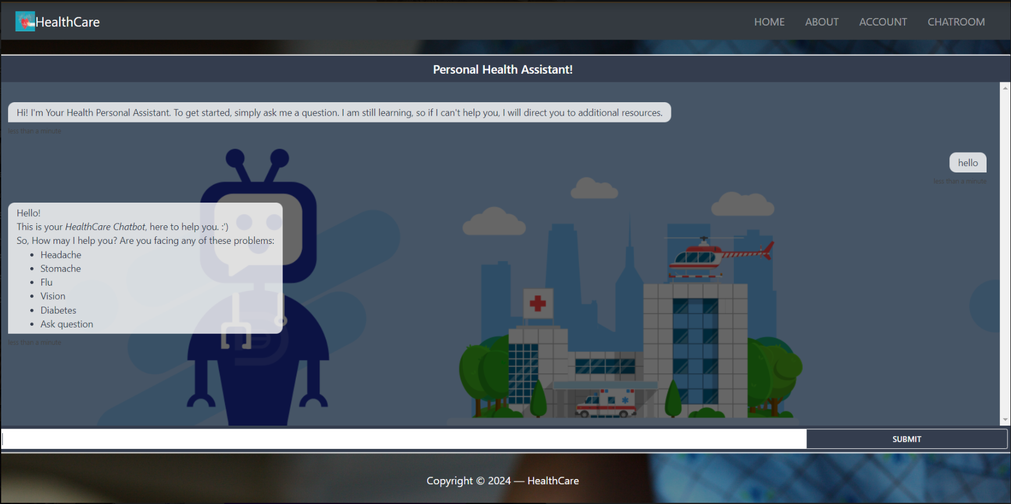

Slide 29
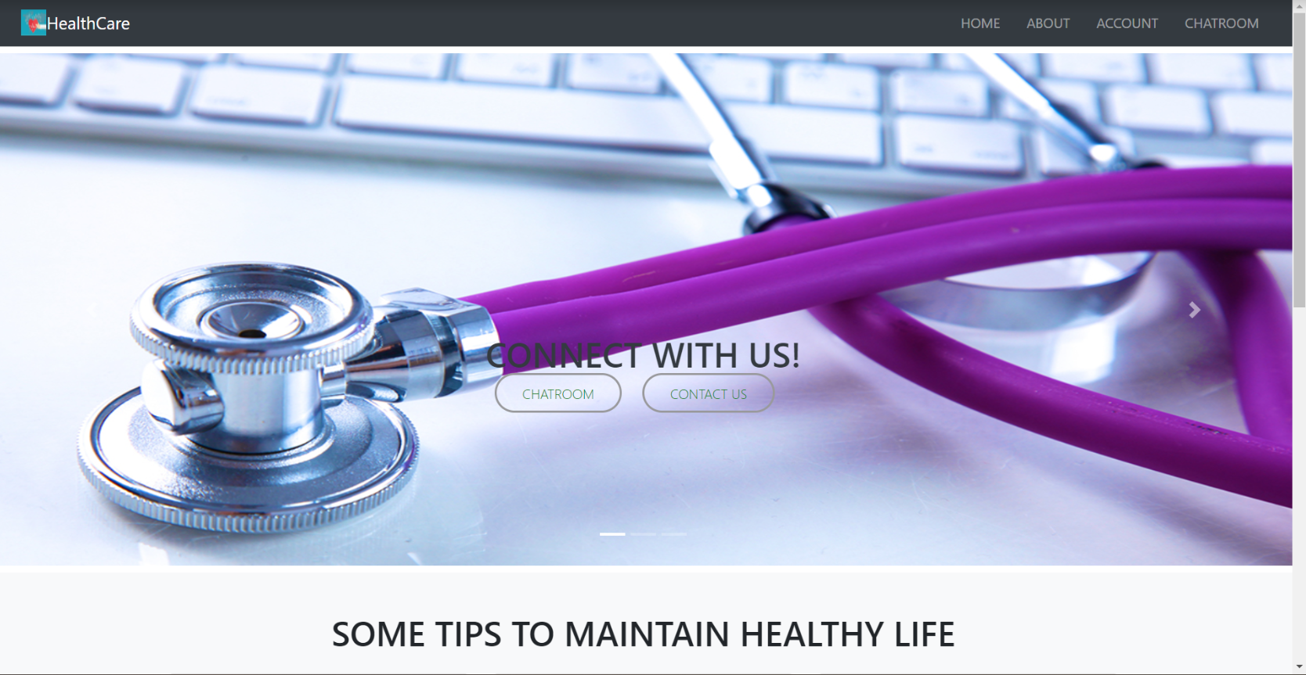

Slide 30
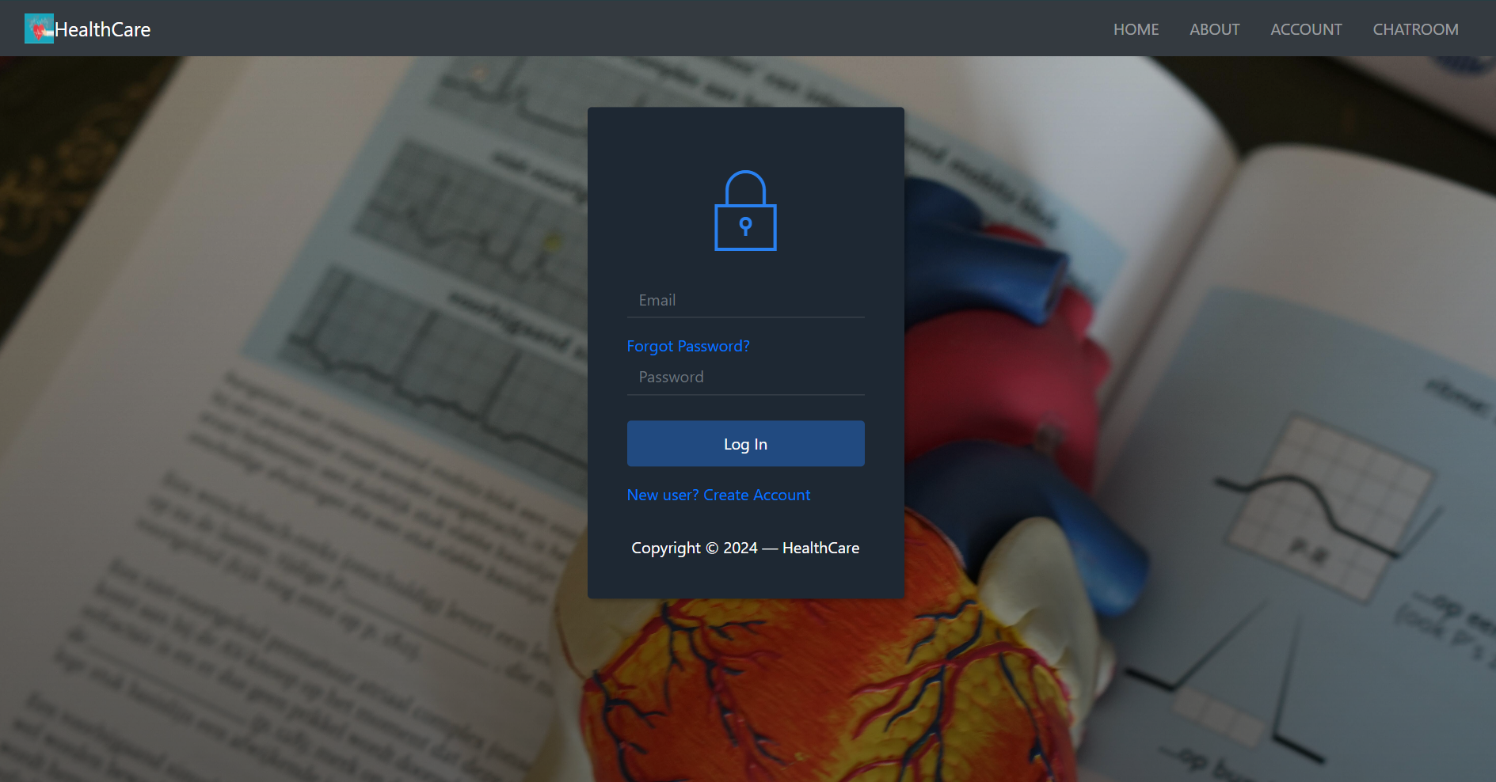

Slide 31
RESOURCES USED FOR DATA
https://www.hopkinsmedicine.org/search?site=jhm&q=stomachache
https://www.hopkinsmedicine.org/health/conditions-and-diseases/headache#:~:text=points%20about%20headaches-,A%20headache%20is%20pain%20or%20discomfort%20in%20the%20head%20or,triggers%20is%20the%20best%20prevention
https://www.healthline.com/
https://www.who.int/news-room/fact-sheets/detail/diabetes

Slide 32


